Slide 1
Housing Sales price & Neighborhood Analysis of Chennai
- Akila Balasundaram
November 11,2019

Slide 2
Synopsis:
1.Introduction:
2.Data
3.Methodology
4.Discussion
5.Conclusion

Slide 3
Introduction
Chennai is one of the Metropolitan cities located in Southern part of India. Chennai is the capital of Tamil Nadu which serves as biggest cultural, economic and educational center of South India. According to 2011 census this city is sixth most populated city of India and together with adjoining regions is 36th-largest urban area by population in the world.
Interest
With above said growth rate and people moving towards Chennai urban area, we are trying to find best neighborhoods for migrated people to settle down based upon housing process and little details on neighborhood.

Slide 4
Data Acquisition and cleaning
Obtained all the areas in Chennai and their pin codes from here.
Most of the housing sale price details ,their areas and various stats from Kaggle data sets from here.
Using Four square API’s to determine the venues for each neighborhood.
Using Geocoder function to get the Lat, Lon values for above dataset.

Slide 5
Records or details for some of the metropolitan areas were added
Records of neighborhoods with missing pin codes were corrected
Records with misspelt neighborhood were corrected
After cleaning and merging data ,the data frame has 6128 rows and 9 columns

Slide 6

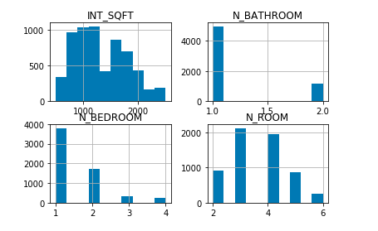
Trends of housing prices

Slide 7

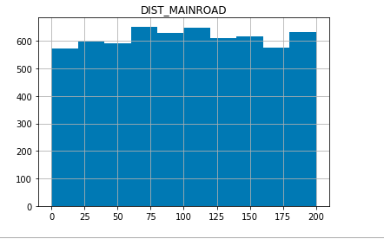
Trends of housing prices

Slide 8
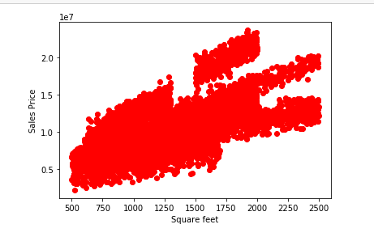
Exploring linearity of the fields with sales price
Square feet VS sales price

Slide 9
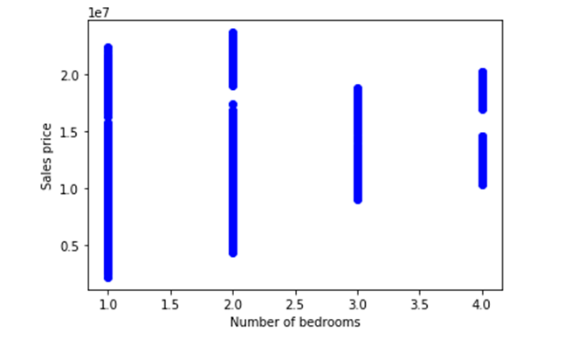
Exploring linearity of the fields with sales price
Number of bedrooms VS sales price

Slide 10
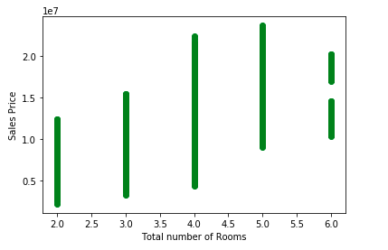
Exploring linearity of the fields with sales price
Total number of rooms VS sales price

Slide 11
Methodology Multiple linear regression
'INT_SQFT','N_BEDROOM','N_BATHROOM','N_ROOM','DIST_MAINROAD' vs SALES_PRICE

Slide 12
This has been evaluated with train and test data and evaluated the variance score
Of 0.64 which is good but there is still room for improvement.80% of the data is used for training and 20% of data was used for testing.
This has been evaluated with train and test data and evaluated the variance score
Of 0.64 which is good but there is still room for improvement.80% of the data is used for training and 20% of data was used for testing.
This has been evaluated with train and test data and evaluated the variance score
Of 0.64 which is good but there is still room for improvement.80% of the data is used for training and 20% of data was used for testing.
The coefficients after applying the multiple linear regression are
Coefficients: [[ 3.39482061e+03 -1.42451424e+06 -2.27928903e+06 2.31744037e+06
8.35844995e+02]]
Evaluation was with 80% of data – training set
20% of data – testing set
variance score=0.64

Slide 13
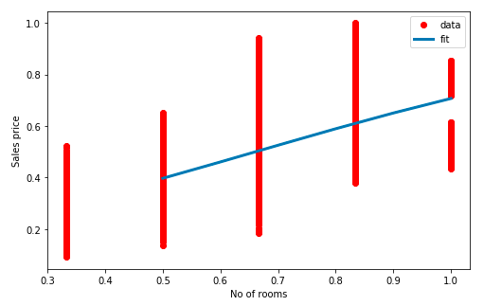
logistic regression with the training data
N_ROOM' vs' SALES_PRICE’
with beta1=0.10 and beta 2=1990

Slide 14
Various methodology and evaluation results
Methodology | Features used | evaluation results
Multiple linear regression | INT_SQFT','N_BEDROOM','N_BATHROOM','N_ROOM','DIST_MAINROAD' vs SALES_PRICE | variance=0.64
 | 'INT_SQFT','N_ROOM' vs SALES_PRICE | variance=0.45
logistic Regression | N_ROOM' vs' SALES_PRICE' | R2 score=-0.31
Polynomial (degree 7) | N_ROOM' vs' SALES_PRICE' | R2 score=-0.34

Slide 15
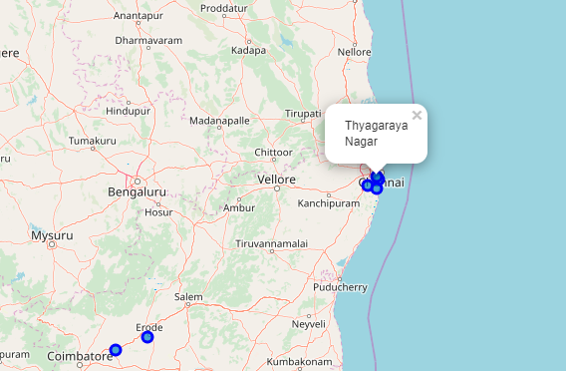
A peek into Neighborhoods of Chennai
As a next part we are going to analyze the neighborhoods of Chennai and going to give a rough idea for the immigrants what are their choices.
Python folium library to visualize geographic details of Chennai and its Neighborhoods

Slide 16
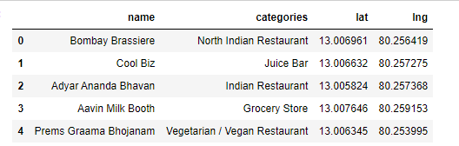
TOP 5 venues of Adyar
Foursquare API to explore the boroughs with limit as 100 venues and radius 500 meter
29 venues were returned for Adyar – Borough in Chennai

Slide 17
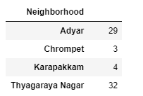
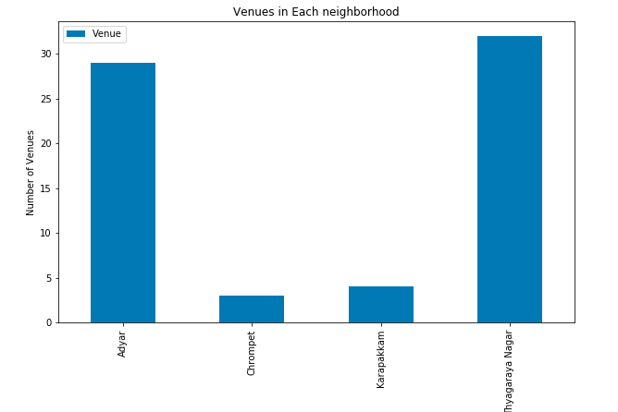
Count of venues for other Boroughs

Slide 18
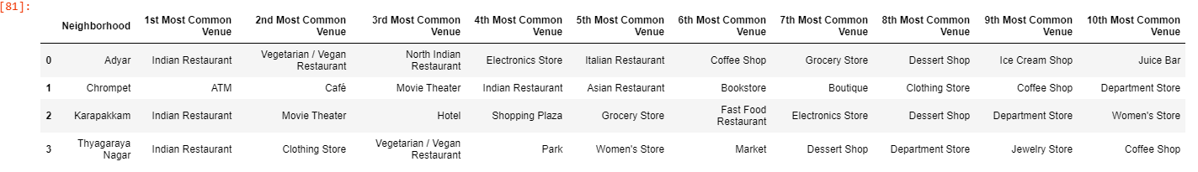
71 unique categories were returned by Foursquare
Top 10 categories for each neighborhood is listed was calculated

Slide 19
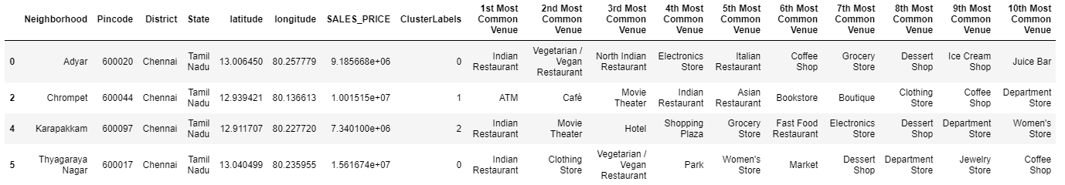
Classification of Neighborhood as clusters based upon K – Means Algorithm
K =3

Slide 20
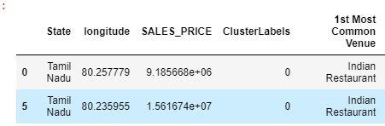
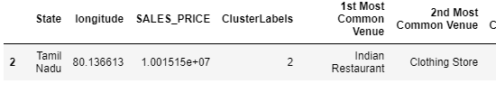
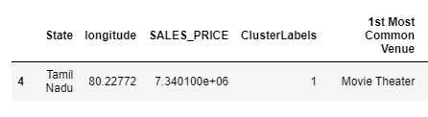
Based upon 1st most common venue the clusters can be classified as
Cluster 0 : “Indian Cuisine Venues
Cluster 2: “Clothing,lifestyle & Intensive Cafe Venues”
Cluster 1: “Entertainment & Social Venues”

Slide 21
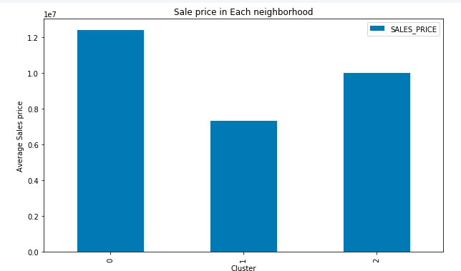
LABELLING CLUSTERS BASED UPON THE HSP (HOSUING SALE PRICES)
Cluster 0 : “High Level HSP”
Cluster 1 : “Low Level HSP”
Cluster 2 : “Mid Level HSP”

Slide 22
CONCUSIONS AND FUTURE DIRECTIONS
Built a useful model for predicting the housing sale prices based upon various factors with a variance of 0.64
Accuracy of the model definitely has room for improvement
Used K means algorithm for clasiification of the clusters
Accuracy can be expanded by expanding the latitude and longitude vales used in the dataset and neighborhood or street can be drilled.
Thid analysis targets the immigrants moving towards big cities for getting a new life, similar kind of analysis can be built targeting investors .

